Slide 1
DENIAL OF SERVICE USING MYSQL RELATIONAL DATABASE STRUCTURE BASED ON NETWORK SECURITY
Prepared By: Guided By: AnMOL BAGHEL Zakir Hussain

Slide 2
Table of content:
What Is Dos?
Types of Dos attack.
Common Attack Techniques.
Protection Against DoS.
Project.

Slide 3
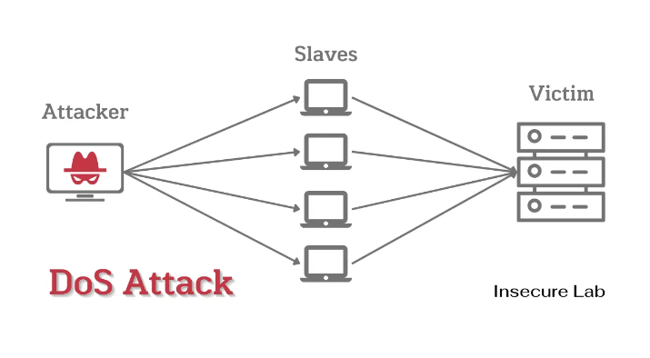
What is DoS?
A Denial of Service (DoS) attack is a type of cyberattack where an attacker attempts to make a computer or network resource unavailable by overwhelming it with traffic or requests.
The goal of a DoS attack is to exhaust the resource's capacity, making it unable to handle legitimate requests

Slide 4
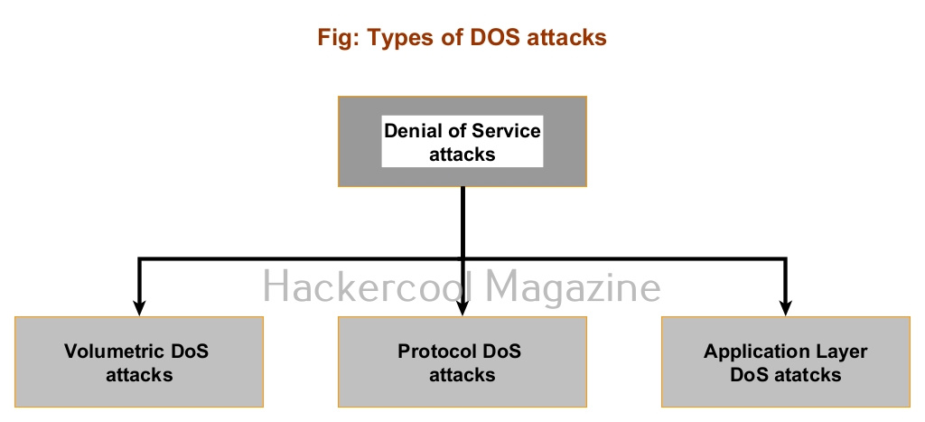
Types of DoS Attacks:
1. Volume-based attacks: Overwhelming the network with traffic to consume bandwidth.
2. Protocol attacks: Exploiting weaknesses in network protocols to consume resources.
3. Application attacks: Targeting specific applications or services to consume resources

Slide 5
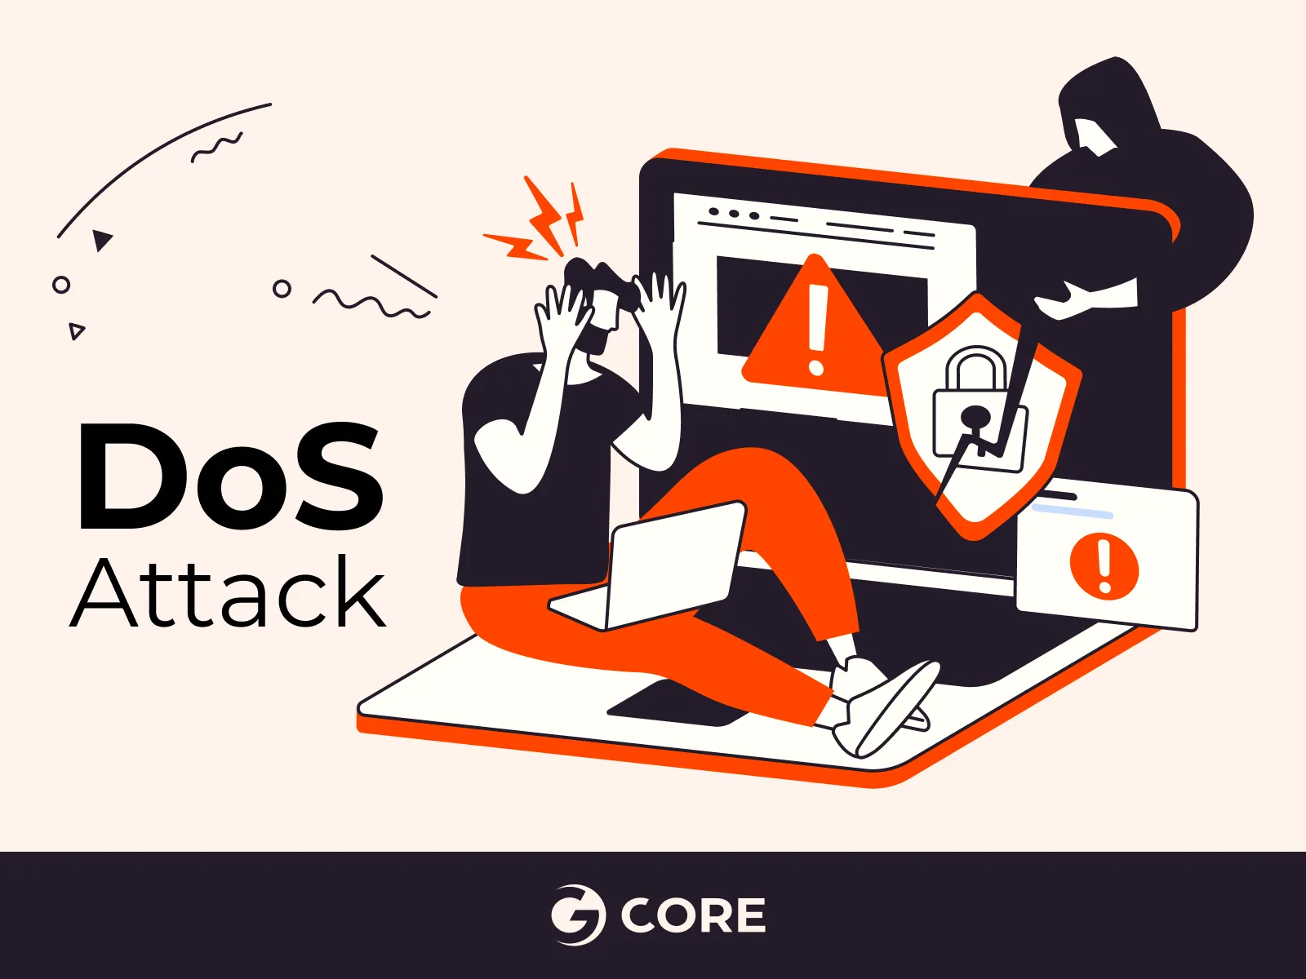
Common Attack Techniques:
Flooding: Sending a large number of requests or traffic to overwhelm the resource. This is like trying to drink from a firehose, where the sheer volume of water is too much for the system to handle.
Buffer overflow: Sending more data than a buffer can handle, causing it to crash. This is like trying to stuff too many people into a small room, causing it to become overcrowded and unusable.

Slide 6
Common Attack Techniques:
Malformed packets: Sending packets with incorrect or malicious data to cause errors. This is like sending a package with the wrong address, causing it to get lost in transit.
SYN flooding: Sending a large number of SYN requests to consume server resources. This is like sending a flood of requests to a server, overwhelming it with traffic and causing it to slow down or crash.

Slide 7
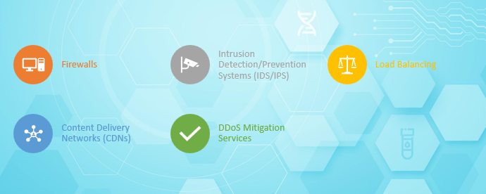
Protection Against DoS:

Slide 8
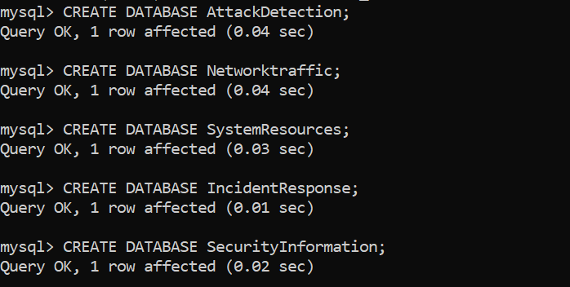
Project:
This project involves 5 databases and 5 key tables in each, designed to detect, monitor, and respond to DoS attacks.
1. Attack_Detection Database :Detect and log DoS attacks in real-time.Tables: Attacks ,attack_types,Sources, detection_rules , alerts.
2.Network_Traffic Database: Monitor network activity to detect abnormal traffic.Tables :traffic, Protocols, ip_addresses ,network_devices, traffic_stats.
3.System_Resources Database:Monitor system resources under attack.Tables: resource_usage ,resources ,system_stats ,process_list , user_sessions

Slide 9
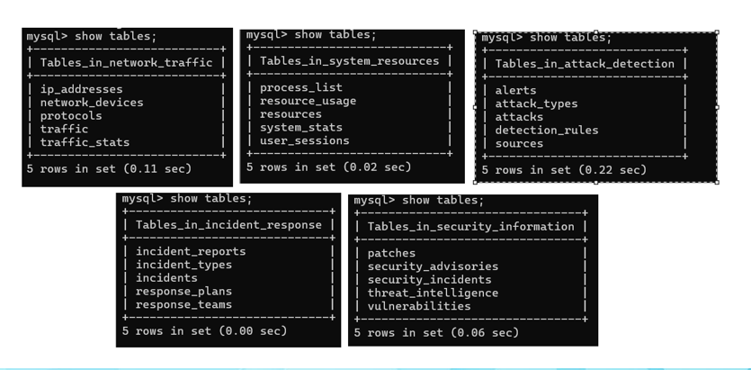
Projects
4.Incident_Response Database:Manage and track responses to DoS incidents.Tables : incidents, incident_types ,response_plans ,response_teams, incident_reports.
5.Security_Information Database :Track vulnerabilities, patches, and threats. Tables: Vulnerabilities,Patches,security_advisories,threat_intelligence,security_incidents.

Slide 10
Final Goal of the Project.:
This project's main goal is to create a flexible, secure, and robust system capable of identify, track, and lessen cyberattacks—especially Denial-of-service attacks. Through leveraging dynamic detection criteria, real-time alerts, and advanced analytics, the system will enhance cybersecurity overall and protect vital assets from constantly changing threats.

Slide 11


